Slide 1



maars: models as approximations in R
Riccardo Fogliato*
(He/Him)
Shamindra Shrotriya*
(He/Him)
Arun Kumar Kuchibhotla
(He/Him)
Carnegie Mellon University
Department of Statistics and Data Science
Notes:
Riccardo Fogliato starts speaking:
Hi everybody! This is the presentation of the maars package.
The name maars stands for models as approximations in R.
We are Riccardo and Shamindra. Both of us are phd students in Statistics at Carnegie Mellon University (CMU)
This is joint work with Arun Kumar Kuchibhotla, who is a faculty member in statistics at CMU.
We are very excited to be presenting this work today so let’s get us started!

Slide 2
Motivation
Notes:
In order to understand the {maars} package better, we first need to revisit Ordinary Least Squares Regression, which is also known as OLS
Moving on to slide 3

Slide 3

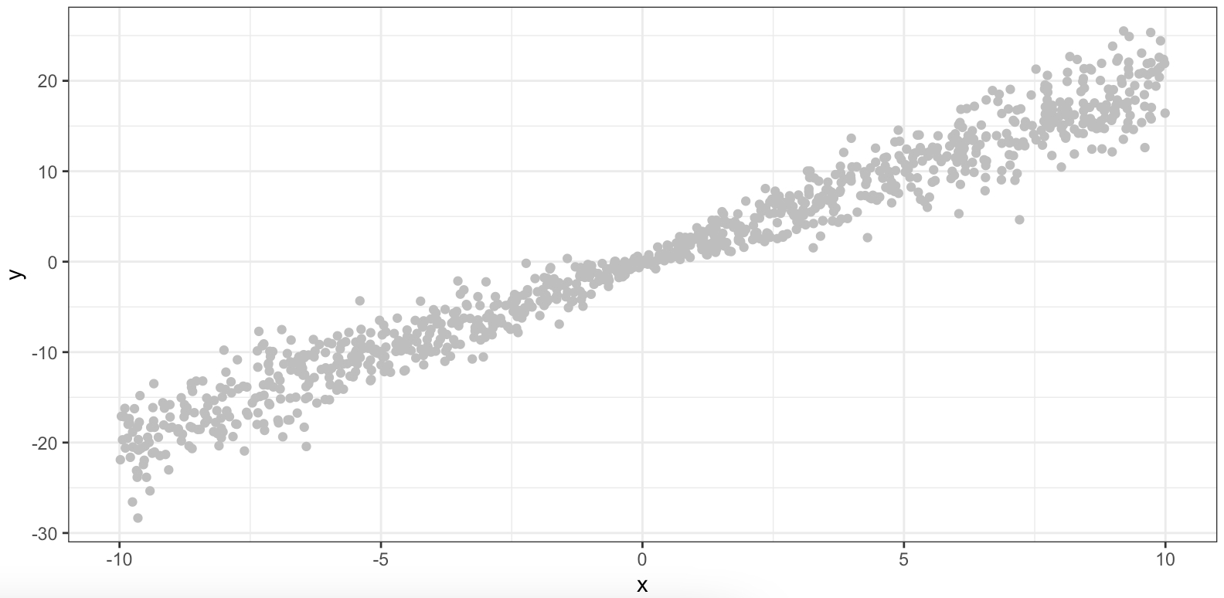
OLS is a great tool
Notes:
OLS is a handy tool that is in every data scientist’s toolkit
When we take our first Statistics classes on modeling, this is generally the first method we encounter.
And it is simply great! We can model so many phenomena by running ordinary least squares (OLS) regression.
Here, for example, we sample a 1000 points from a simple linear model (without intercept)
We might think of employing a linear regression model to describe the population-level dependence of y on x for the points represented in this figure.
Moving on to the slide 4

Slide 4
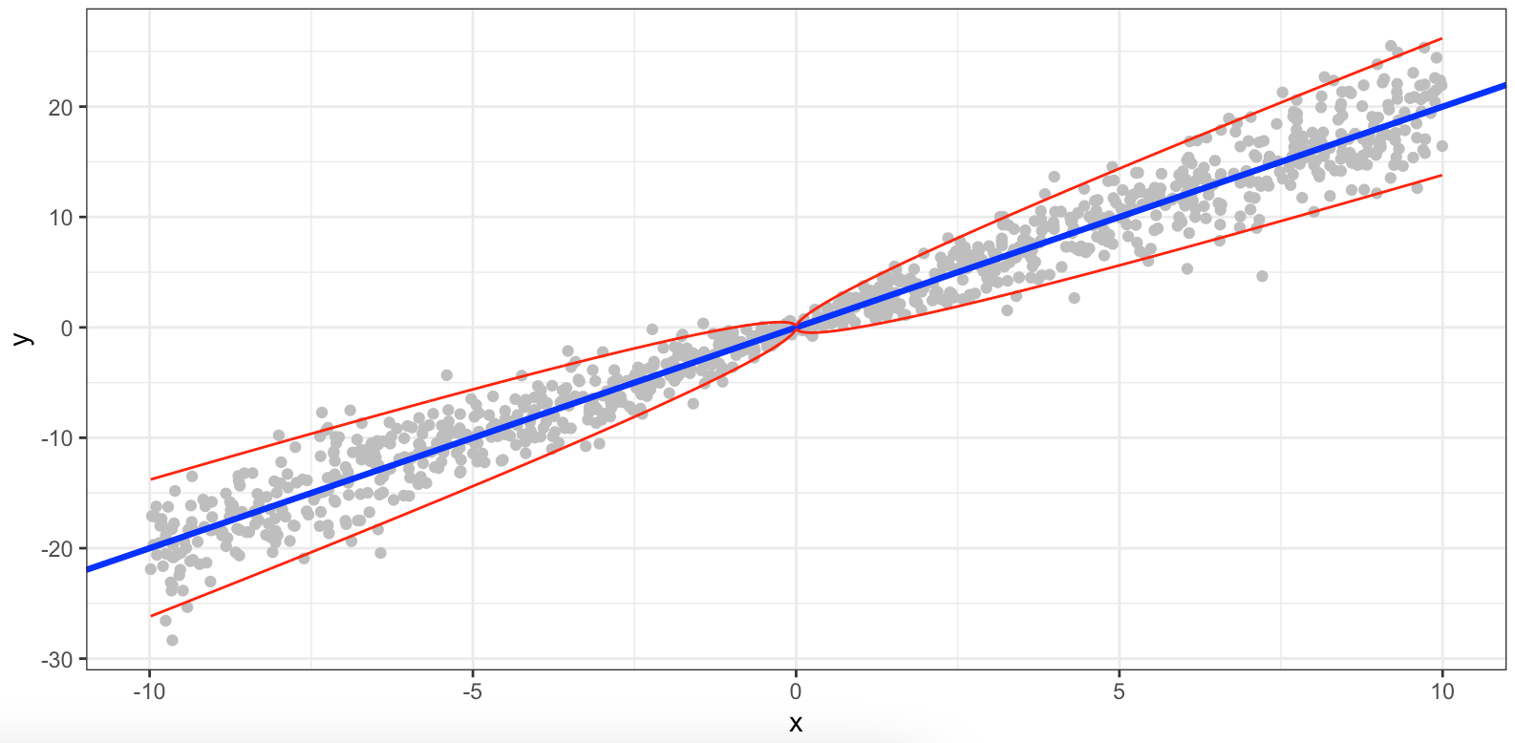
OLS is a great tool... built on often unrealistic assumptions
Notes:
As in any good thing, however, there is a catch: Here, we often forget that OLS is built on a series of assumptions.
The inference for OLS is based on a well-specified linear model
For example in the simulated data that we show, the trend is indeed linear, but the variability of the error terms around the regression line changes with x
In this figure, the blue line represents the fitted regression line, whereas the red lines represents 95% confidence intervals for the residuals
This is in violation of one of the assumptions of OLS
Non-constant variability is indeed a common occurrence in practice!
Moving on to slide 5

Slide 5
Can we still make inference?
> lm_fit <- lm(y ~ 0 + x)
> confint(lm_fit)
2.5 % 97.5 %
x 1.970419 2.020575
Confidence interval is constructed based on OLS assumptions:
i.i.d. observations
linearity
homoscedasticity
Homoscedasticity is broken. Coverage is below 90%
Notes:
But the real question is: Can we still make inference on the coefficient of interest even if one of the OLS assumptions is not met?
So after having fitted a model without intercept on the data via lm(), we can call confint() to get the 95% confidence interval for this coefficient.
This confidence interval assumes homoscedasticity, that is constant conditional variance
However, once we check the estimated coverage based on multiple replications, we find out that it is below 90%.
This means that if we generate the data and fit the model 100 times, the interval will contain the true parameter in less than 90 cases in expectation!
This behavior is absolutely undesirable.
Moving on to slide 6

Slide 6
Can we still make inference?
Inferential tools:
{car}
{clubSandwich}
{lmtest}
{sandwich}
...
{maars}
> lm_fit <- lm(y ~ 0 + x)
> confint(lm_fit)
2.5 % 97.5 %
x 1.970419 2.020575
Confidence interval is constructed based on OLS assumptions:
i.i.d. observations
linearity
homoscedasticity
Homoscedasticity is broken. Coverage is below 90%
Notes:
Then how can we still make inference when we are dealing with models that do not satisfy all of the OLS assumptions?
Luckily there are some excellent R packages such as car, clubsandwich, lmtest, sandwich, for performing OLS inference under misspecification.
And now also we have the maars R package, the package that we are introducing!
I’ll pass it on to Shamindra now

Slide 7
{maars}
models as approximations in R
Notes:
Shamindra Shrotriya starts speaking:
{maars} stands for “Models as approximations in R” and it’s been inspired by the discussion papers written by a group of statisticians at Wharton.
These papers have recently been published in Statistical Science and we highly recommend reading them.
Going back to the packages Riccardo mentioned, given that the existing R packages are so great, why create a new package?
Now let’s turn our attention to our {maars} package and its features

Slide 8
{maars} implements the following inferential tools
Empirical Bootstrap
lm() variance estimator
Residual Bootstrap
Chi-square tests
Sandwich Estimator
Multiplier Bootstrap
Misspecification diagnostics
Subsampling
All of these tools are easily accessed via the comp_var() function!
Notes:
The {maars} package comes “batteries included” with a rich set of inferential tools for OLS under misspecification
These inferential tools fall into 3 main categories
First we have on the left we have the closed form variance estimators which are computed by default i.e. lm() and sandwich standard errors
Second we have resampling based estimators which also help you diagnose convergence to normality
These include the empirical, multiplier, residual bootstrap, and subsampling based methods
Third, we provide by default valid hypothesis testing under model misspecification i.e. chi-square tests rather than F-tests, and also experimental misspecification diagnostic tools including nonlinearity detection
We note that lm() variance and residual bootstrap (highlighted in yellow) are only valid under the full OLS assumptions
The remaining variance types perform valid inference under complete model misspecification
Most importantly, all of these tools are accessible via our single comp_var() function, which is set up for more such tools in the future!
Moreover, the output of the comp_var() function readily allows for a quick comparison of all of these estimators, thus leading to misspecification diagnostics

Slide 9
{maars} places an emphasis on pedagogy
1
2
3
Make OLS assumptions explicit
to the user
Teaching via examples
Tidy inference under model misspecification
Minimize research overhead to data scientist
Research level vignettes +
lesson plans
Consistent grammar for easier communication
Notes:
Although having such inferential tools is helpful to the data scientist, what distinguishes {maars} from other packages?
The key idea which makes maars unique is its strong emphasis on pedagogy, not just for research
We make this pedagogical emphasis clear to new users in 3 key ways:
First, maars explicitly allows the user to print the inferential assumptions for the different variance estimators.
This is to minimize the time overhead for the data scientist. Specifically so that they don’t have to spend time looking up research papers discussing the assumptions behind the different estimators and their validity for inference
By making these assumptions explicit in our output, we hope that it makes these tools less intimidating and accessible to new users
Second, we try to explicitly emphasize teaching these concepts to new users by example
We do this mainly through writing detailed vignettes. These come in 2 main forms, the first is where we take research papers on similar topics and reproduce tables and plots from them, again increasing accessibility for the data scientist to the research
Second we provide lesson plans through vignettes. For example we know empirical, and multiplier are valid under model misspecification, but how different are they in practice? We can use maars to conduct systematic simulations and provide a detailed comparison between these estimators
Third, maars follows tidy principles in it’s function namings, and it’s focus on returning tidy tibbles for downstream analysis

Slide 10
{maars} uses tidy grammar for pedagogy and research
Objects = “nouns”
Functions = “verbs”
Code = “composition”
lm
maars_lm
print()
summary()
confint()
get_summary()
get_confint()
get_assumptions()
comp_var()
<prefix_action>_<target>
lm_fit %>%
comp_var() %>%
get_summary() %>%
filter(var == “sand”) %>%
ggplot(data = ., ...) +
...<more analysis>
%>% = “and then”
+
%>%
Notes:
Before seeing maars in action, it is worth quickly describing what we mean by our tidy maars grammar
The main idea here is that {maars} code for performing OLS inference under misspecification should be ideally written and read as prose, left to right, top to bottom
We note that this idea is not new, and we were inspired by the tidyverse and similar packages
In our grammar, on the left we see that the main “nouns” are lm, maars_lm objects. In the middle, our verbs are the maars functions which act on these objects.
These include generic methods such as summary(), print(), confint() etc. We also have a tidy analogue for each of these with the get_ prefix, which reminds the user that the object returned is a tidy tibble, similar to {broom} package
We name maars functions using a consistent convention so that both reading and writing maars code aligns with communication of these ideas
Lastly code composition in maars becomes easy using the magrittr pipe operator, so that these deep statistical and econometric ideas can be communicated easily as prose

Slide 11
{maars}
Demo Time!
Notes:
We have discussed the key principles upon which maars is based.
It’s now time to get hands-on and see briefly what a {maars} workflow looks like

Slide 12
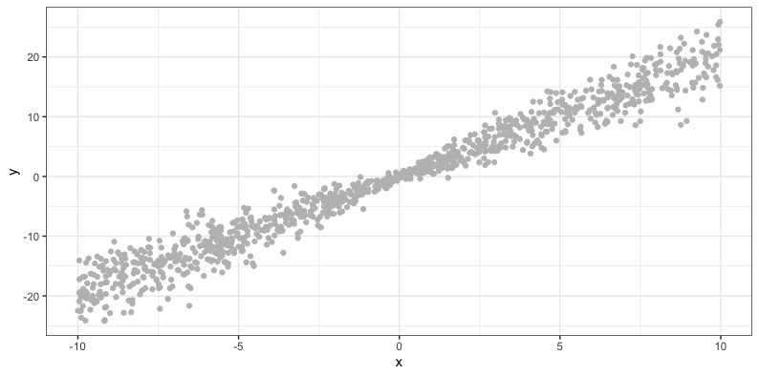
Demo - returning to our simulated data
n <- 1e3
x <- runif(n,-10,10)
y <- 2 * x + rnorm(n, 0, sqrt(abs(x))
Generating process is linear but heteroscedastic!
Notes:
To begin our demo, we will work in a simulated setting
Recall the simple (toy) example that Riccardo presented earlier….
Here we generate data from linear model with heteroscedastic noise, where the variance is not equal across observations …
For interest, on the left is what the R code used to generate this type of plot looks like
So how would we go about modeling this relationship?

Slide 13
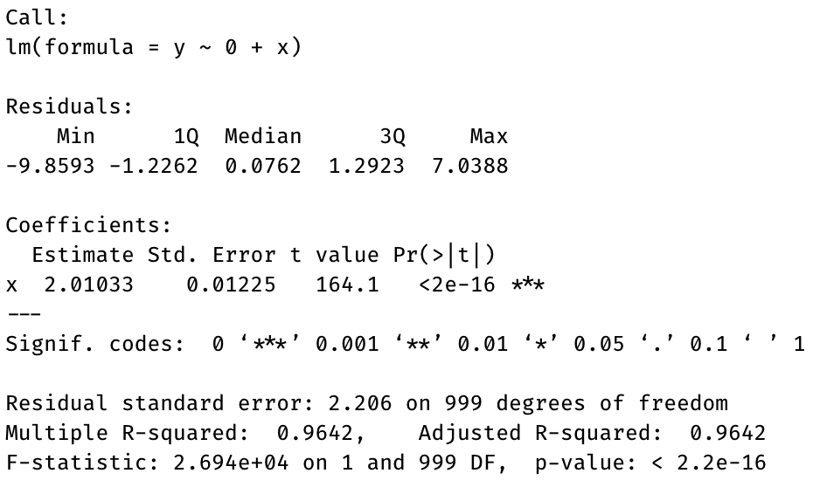
The lm() workflow
lm_fit <- lm(y ~ 0 + x)
summary(lm_fit)
The OLS parameter estimate is correct
Standard errors are calculated on violated assumptions!
Notes:
Since we know (and believe) the data is generated from a linear model we can still start by running the lm workflow
By running the usual summary command on our fitted lm_fit object, we get that the OLS estimate of the coefficient is correct
But of course, as shown earlier the SEs don’t provide the appropriate coverage of the true parameter anymore
So how can we use maars to perform inference in this situation?

Slide 14
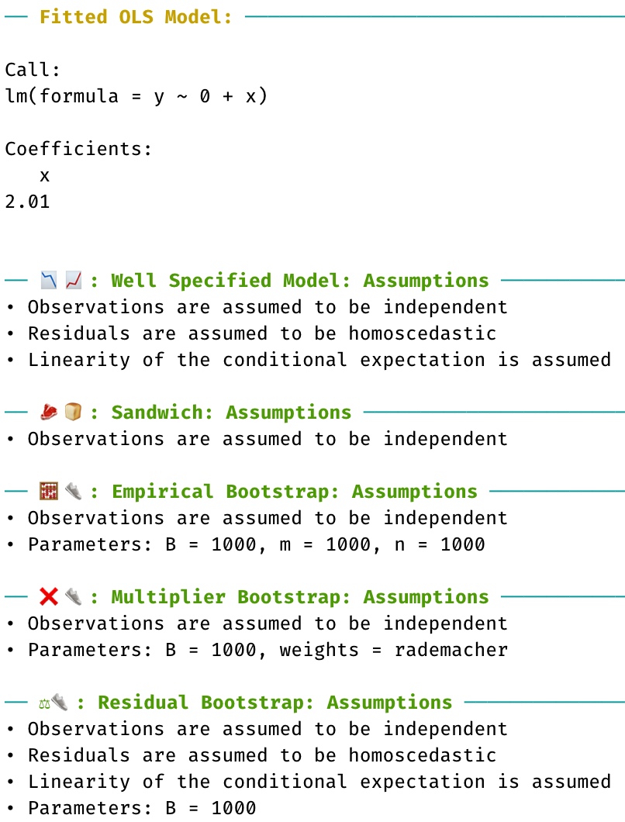
The comp_var() workflow in {maars}
maars_fit <- lm_fit %>%
comp_var(boot_emp = list(B = 1e3),
boot_mul = list(B = 1e3),
boot_res = list(B = 1e3))
print(maars_fit)
Notes:
We note that every maars workflow begins with fitting lm, as we just did
Next, we take our lm object and pipe it into comp_var(), the most important function in {maars}
This creates a new object of class “maars_lm”, in this case named maars_fit
The comp_var() design is simple, and in this case we ask for the empirical bootstrap, multiplier bootstrap, and residual bootstrap standard errors to be computed, with 1000 replications each
In this case, we created our maars object, implicitly using many default inferential assumptions. How can we explicitly check what these assumptions are?
We just print our maars_fit object!
The print method explicitly conveys the inferential assumptions used, and even reveals what default assumptions were run e.g. multiplier bootstrap was run using default “rademacher” weights
We built this feature for ourselves in the development process, but many users liked that the object made the inferential assumptions explicit
We hope this catches on in the R community, and more assumptions behind objects are made explicit using the generic print methods
I’ll now pass to Riccardo to describe more maars methods

Slide 15
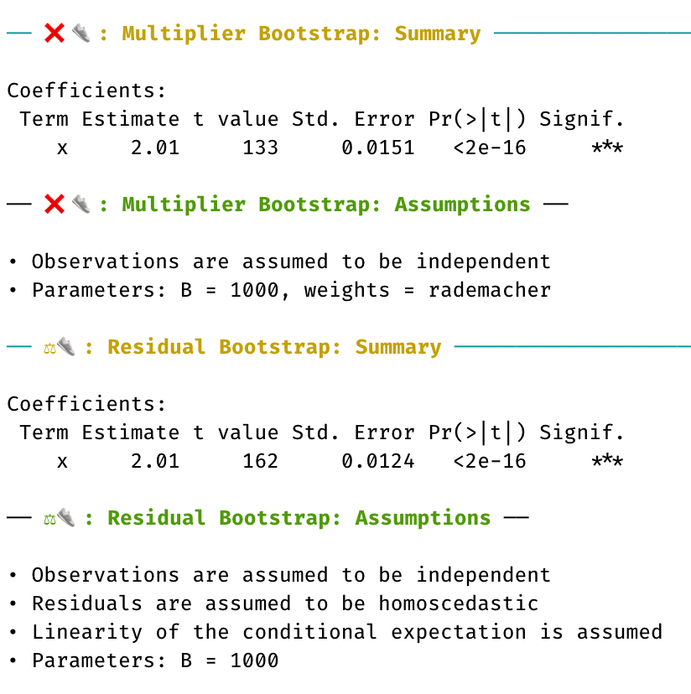
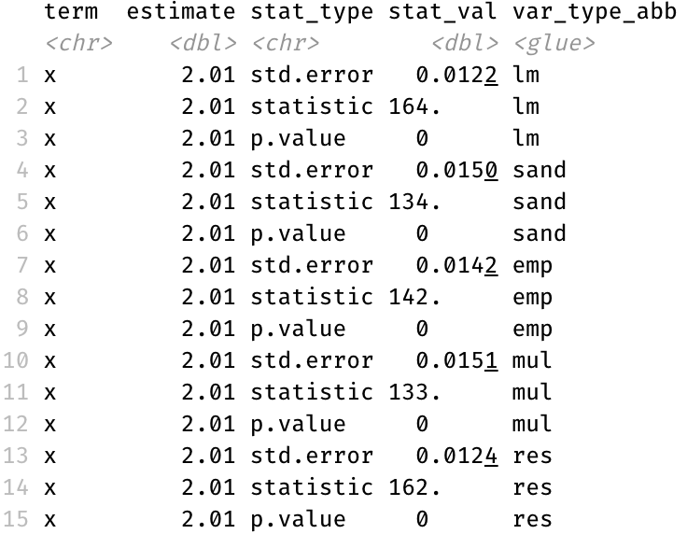
Most generic methods have a tidy analogue in {maars}
summary(maars_fit)
get_summary(maars_fit)
Notes:
Riccardo starts speaking again:
Most of the generic methods that are currently implemented in maars have tidy analogues.
For example, we can call the typical summary method also on a maars object.
This method does exactly what we would normally expect from calling summary on an lm() object, it just looks a bit nicer (or at least we think so).
Our summary displays the assumptions together with both the coefficients estimates, standard errors estimates, p-values, and so on.
However, we can also obtain similar information in the form of a tibble by calling the get_summary() function.
Thus, we say that get_summary() is the tidy analogue of summary().
This idea of the analogues extends beyond summary.
Moving on to slide 16

Slide 16
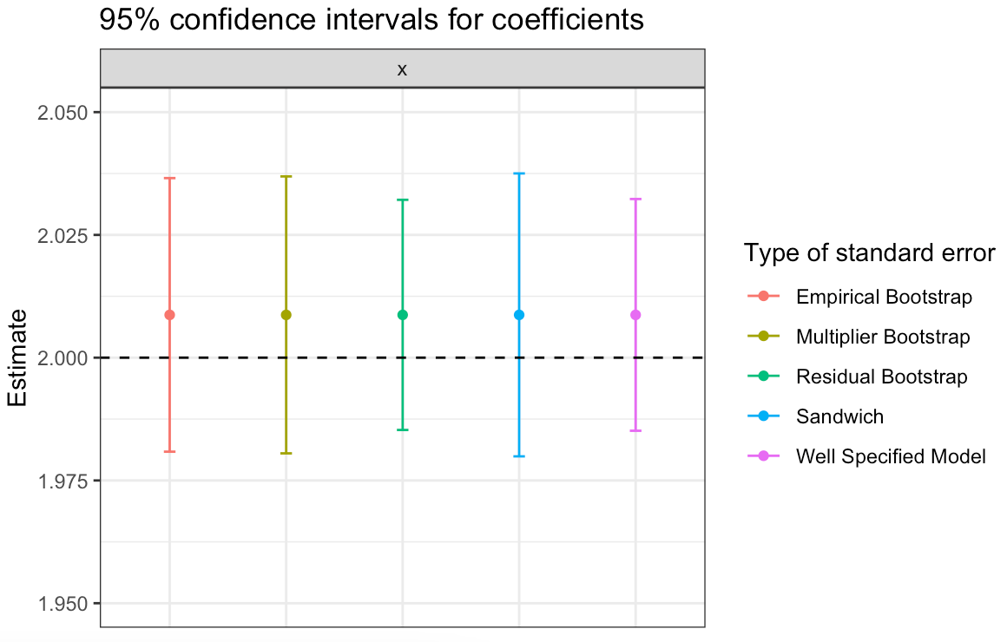
A simple tidy plotting workflow in {maars}
maars_fit %>%
get_plot() %>%
pluck('p7') +
ylim(1.95, 2.05)
Notes:
Again, we try to embrace the tidy workflow and here is another example
Where we call the get_plot() function on a maars object to obtain eight model diagnostics.
Six of these diagnostics are the same that you would get from calling plot() on an lm object, plus two additional diagnostics.
The first of these two diagnostics is shown here in this plot and it displays the confidence intervals for the estimate of the coefficient.
Each interval is based on a different type of method for computing the variance, and, as we might expect, we see that the intervals widths differ.
Moving on to slide 17

Slide 17
Upcoming {maars} features
Polish and optimize code for current features
Clean documentation
Develop user-friendly pedagogical vignettes
New functionalities: anova, conformal inference via predict()
Extend beyond OLS e.g. GLMs
Notes:
Ok, this was a very quick dive into maars and we have absolutely not covered all of its functionalities.
What are the key upcoming features we have in our pipeline?
First, we plan to polish documentation and features, which includes making our code faster also by parallelizing it.
We also plan to spend some time developing user-friendly vignettes.
Then, we plan to spend some time on new functionalities such as anova and using conformal inference for predictions.
Lastly, one very important element: We want to extend the package to cover GLM and other models!
Moving on to slide 18

Slide 18
References
Buja, Andreas, et al. "Models as approximations I: Consequences illustrated with linear regression." Statistical Science 34.4 (2019): 523-544.
Buja, Andreas, et al. "Models as approximations II: A model-free theory of parametric regression." Statistical Science 34.4 (2019): 545-565.
Wickham, Hadley, et al. "Welcome to the Tidyverse." Journal of Open Source Software 4.43 (2019): 1686.
Wickham, Hadley. "Tidy data." Journal of statistical software 59.10 (2014): 1-23.
The Tidy Tools Manifesto (2020): https://tidyverse.tidyverse.org/articles/manifesto.html
Notes:
These are some references to papers that we cite in this presentation

Slide 19
Please take {maars} for a test-run!
Thank you!
install.packages(“pak”)
pak::pkg_install(“shamindras/maars”)
library(“maars”)
Official: https://shamindras.github.io/maars/
We’d appreciate your feedback on functionality, grammar, and vignettes
Notes:
To conclude, you can install the package via the “pak” package from github or via “devtools”. We will soon push the package on to CRAN as well.
We would love your feedback, so please try our package and let us know what you think or make a contribution! And don’t hesitate to open an issue.

